Slide 1
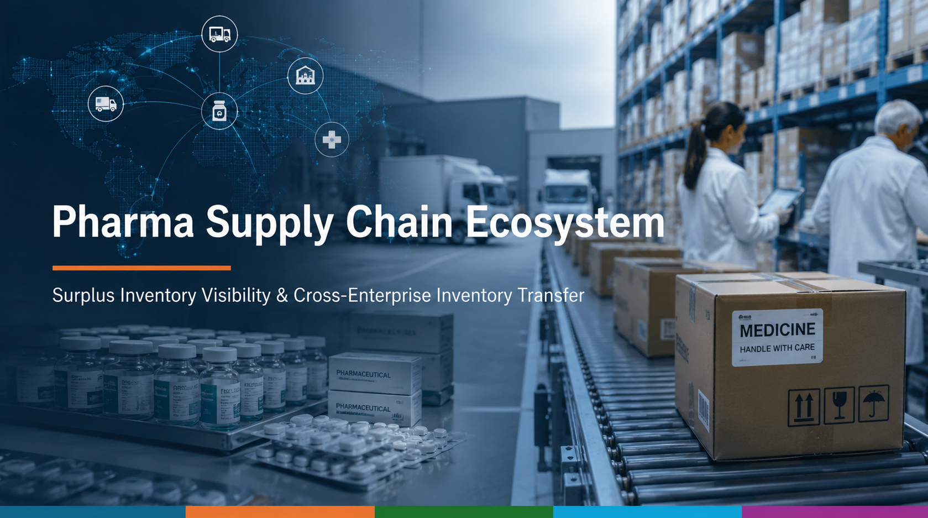

Slide 2
The Challenge & Our Solution
The Challenge
Our Solution
Current pharmaceutical supply chains face several major challenges:
Medicine shortages caused by unstable manufacturing
Limited visibility of inventory across organizations
Protective purchasing that creates inventory imbalances
Medicine expiration caused by excess inventory
Lack of collaboration among supply chain participants
Our solution provides the following key features:
Surplus Inventory Visibility Provide ecosystem-wide visibility of surplus inventory through role-based access control.
Cross-Enterprise Inventory Transfer Enable wholesalers to transfer surplus inventory before requesting replenishment from manufacturers.
Integrated Workflow Connect suppliers, manufacturers, transporters, wholesalers, and hospitals through standardized WorkRequest workflows.
2

Slide 3
Supply Chain Ecosystem Map
Enterprise
Replenishment request
Wholesaler A
Hospital A
Inventory transfer
request
Supplier
Manufacturer
Transporter
Wholesaler B
Hospital B
Material
request
Delivery
request
Procurement
Request
Cargo flow
Work request
Wholesaler C
Hospital C
Organization
Supplier
Production
Quality Assurance
Transport
Inventory
Shipping
Procurement
Pharmacy
Role
Supplier Admin
Material Shipping
Production Admin
Production
Quality Assurance
Transport Admin
Driver
Inventory Admin
Shipping Order
Shipping
Procurement
Pharmacy
Key assumptions
Hospitals procure medicines through their assigned wholesalers.
Wholesalers may transfer surplus inventory between participating wholesalers during shortages.
Manufacturers replenish wholesalers when surplus inventory is unavailable.
Transportation is managed through the Transporter enterprise for manufacturer deliveries.
Participating enterprises share inventory information through role-based access control.
3

Slide 4
High-level Component Diagram
Ecosystem
Enterprise
Organization
Management
User Management
Workflow Management
Organization
Role
User Account
Work Queue
Work Request
Request
Processing
4

Slide 5
Supplier — Roles & Workflow
Work flow
Work request
Organizations: Supplier
Supplier Admin
Material Shipping Operator
(Manufacturer)
Create Material request
Receive Material Request
Picking
Check Inventory
Create Picking Order
Picking complete
Release Picking Order to shipping
Shipping
Manage operator account
Manage admin account
Update shipping / material request Status
5

Slide 6
Manufacturer — Roles & Workflow
Work flow
Work request
Organizations: Production , Quality Assurance
Production Administrator
Production Operator
Quality Assurance
Create Material Request
To supplier
(Supplier)
Shipping material
(Supplier)
Receive Material Request
Receive Raw Materials
(Wholesaler)
Create Replenishment Request
Execute Production
Receive Finished Goods
Create Production Plan
Register Finished Goods
Execute Quality Inspection
Issue Delivery Request
To transporter
Enter Quality Inspection result
(Transporter)
Receive Delivery Request
Shipping
Manage admin account
Manage operator & QA account
Update shipping Status
6

Slide 7
Logistics — Roles & Workflow
Work flow
Work request
Organizations: Transport
Transport Administrator
Driver
(Manufacturer)
Create Delivery Request
Loading
Receive Delivery Request
Delivery
Scheduling
Unloading
Truck arrangement
Confirm Delivery Condition
Create Delivery Order
Obtain Proof of Delivery
Report Delivery result to Requester
Manage admin account
Manage driver account
Manage fleet
7

Slide 8
Wholesaler — Roles & Workflow
Work flow
Work request
Organizations: Inventory, Shipping
Inventory Administrator
Shipping Order Staff
Shipping Operator
Check another wholesaler inventory
In case stock shortage occurs
(Transporter)
Delivery product
Transfer Request
To another wholesaler
Receive medicines
Check inventory
Create replenishment
Request to manufacturer
Receive Procurement Request
/ Inventory Transfer Order
Picking
(Manufacturer)
Receive replenishment request
Issue Picking Order
Packing
(Hospital)
Receive procurement request
Shipping
Send to Shipping
(Hospital)
Receive Procurement Order
Manage admin account
Manage staff & operator account
8

Slide 9
Hospital — Roles & Workflow
Work flow
Work request
Organizations: Procurement, Pharmacy
Procurement Administrator
Pharmacy Operator
Dispensing
Create Procurement Request
To Wholesaler
Check inventory
(Wholesaler)
Receive Procurement Request
Check expiry date
Replenish request
(Wholesaler)
Shipping medicine
Receive medicine
Store medicine
Manage admin account
Manage operator account
Manage PO
9

Slide 10
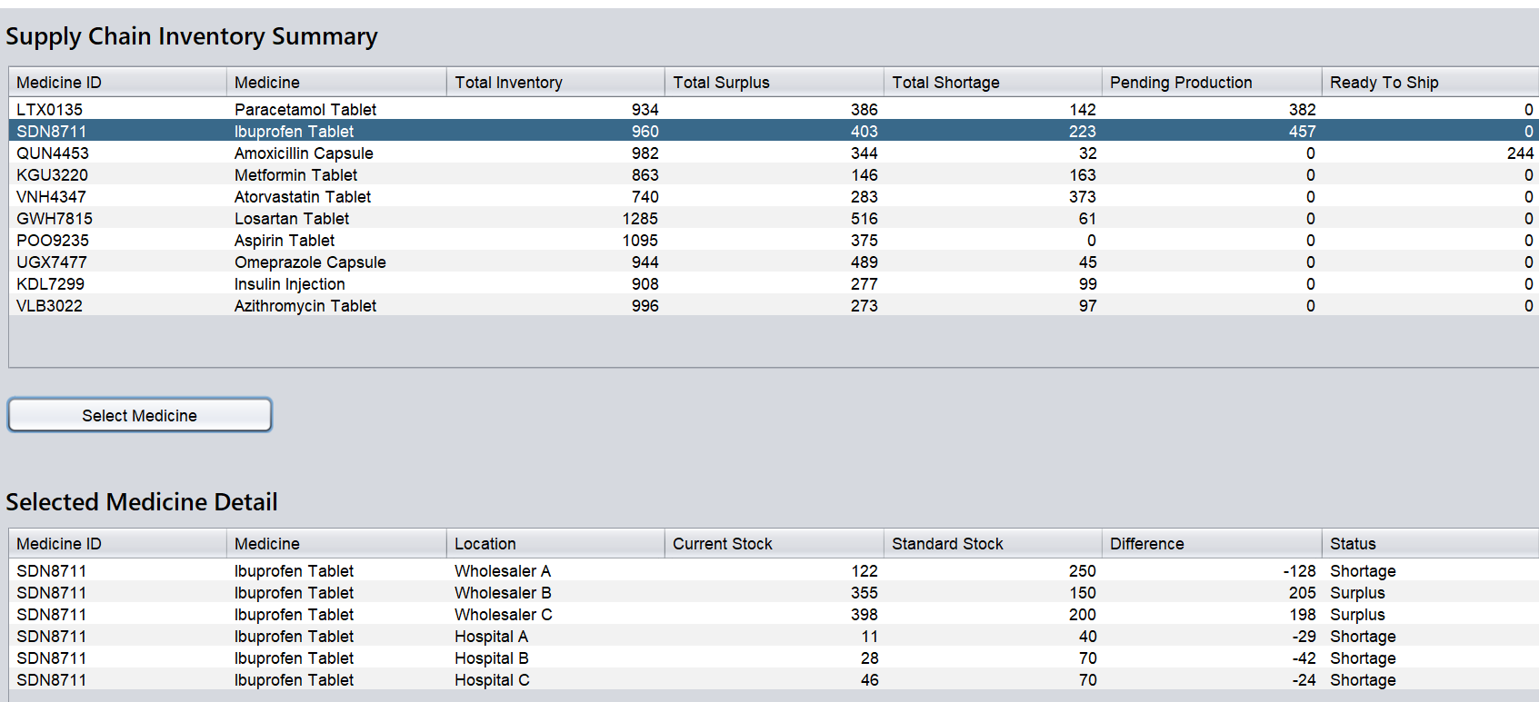
Supply Chain Dashboard
The Supply Chain Dashboard provides enterprise administrators with a real-time overview of inventory across the pharmaceutical supply chain.
The dashboard enables administrators to quickly identify shortages, monitor production progress, and support inventory balancing across the supply chain.
Key features
Ecosystem-wide inventory visibility
Total inventory, surplus, and shortage by medicine
Pending production and ready-to-ship quantities
Medicine-level inventory details across wholesalers and hospitals
10

